Slide 1
Habitability of Exoplanets
Ben Prentice and Noah Psutka

Slide 2
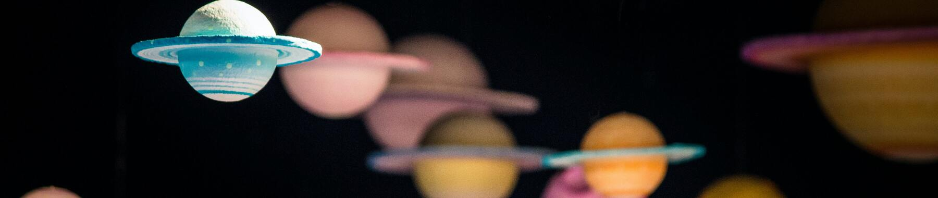
Problem Statement
Data from The Habitable Exoplanets Catalog
binary/trianary classification prediction model
The class label we predicted will be in regards to the habitability of an exoplanet;
not-habitable = 0, habitable = 1, strong habitability = 2

Slide 3
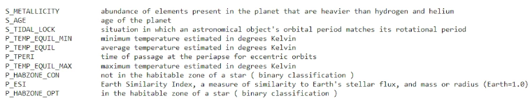
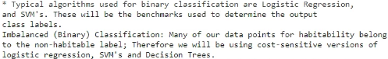
Project Data/Model Information

Slide 4
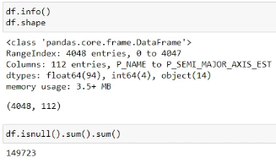
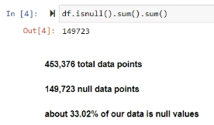
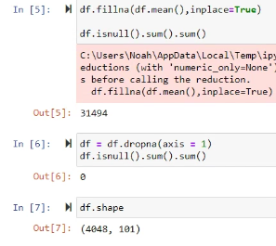
Data Preprocessing

Slide 5
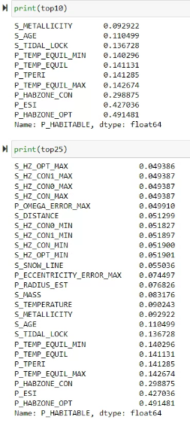
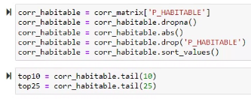
Feature Extraction

Slide 6
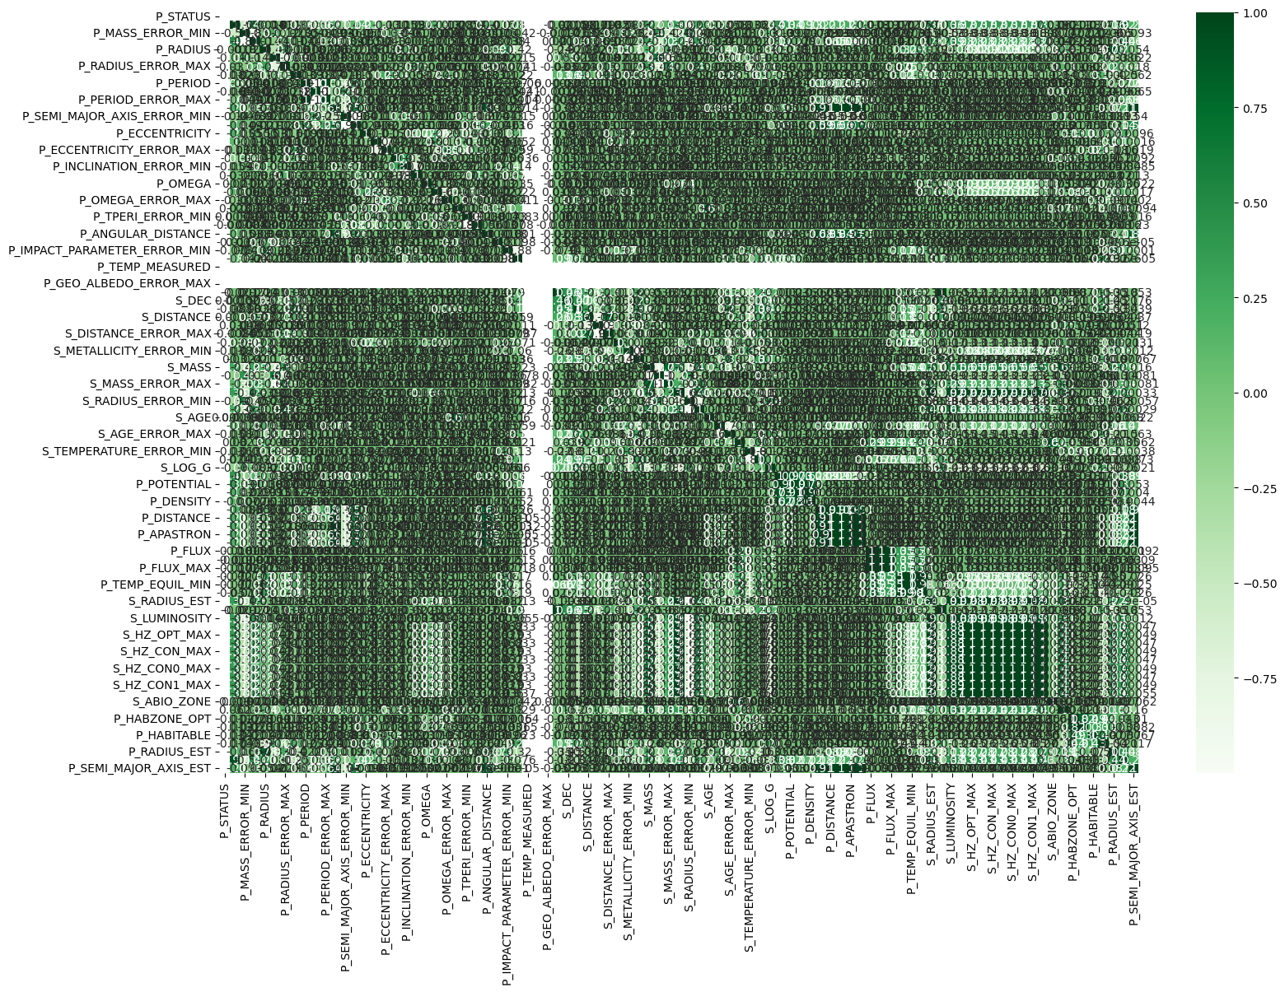
Baseline Correlation Matrix

Slide 7
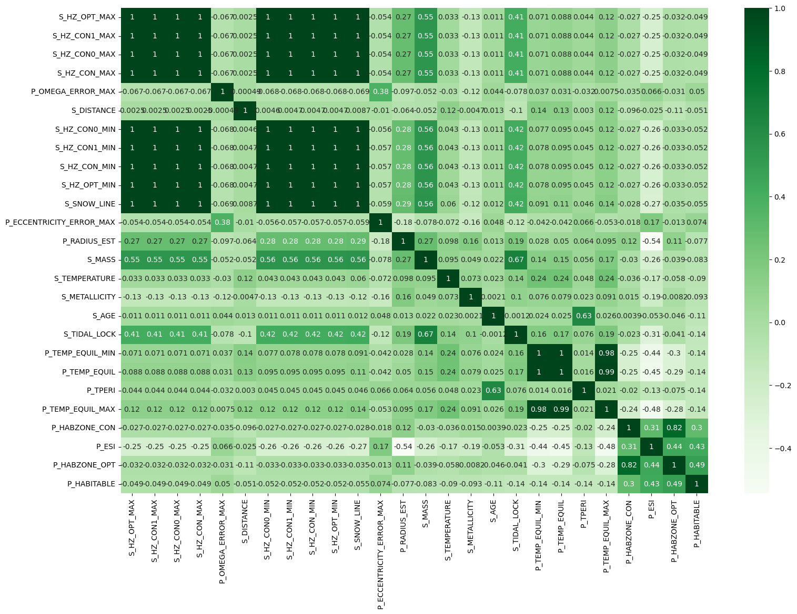
Top 25 Correlation Matrix

Slide 8
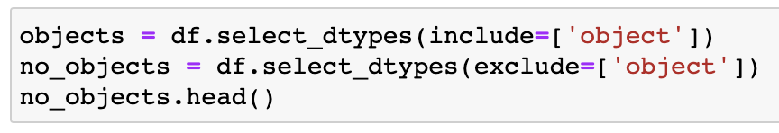
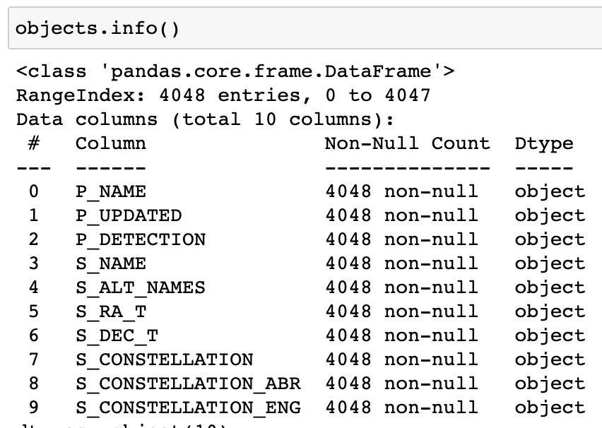
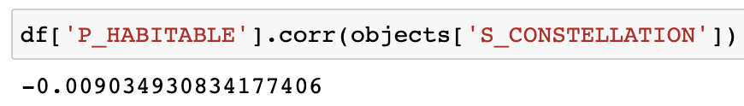
Label Encoding

Slide 9
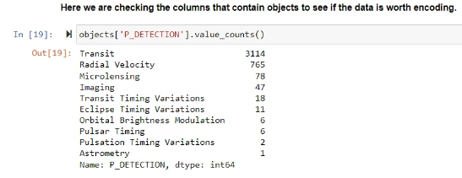
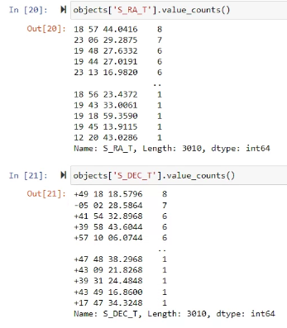
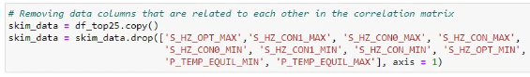
Feature Selection

Slide 10
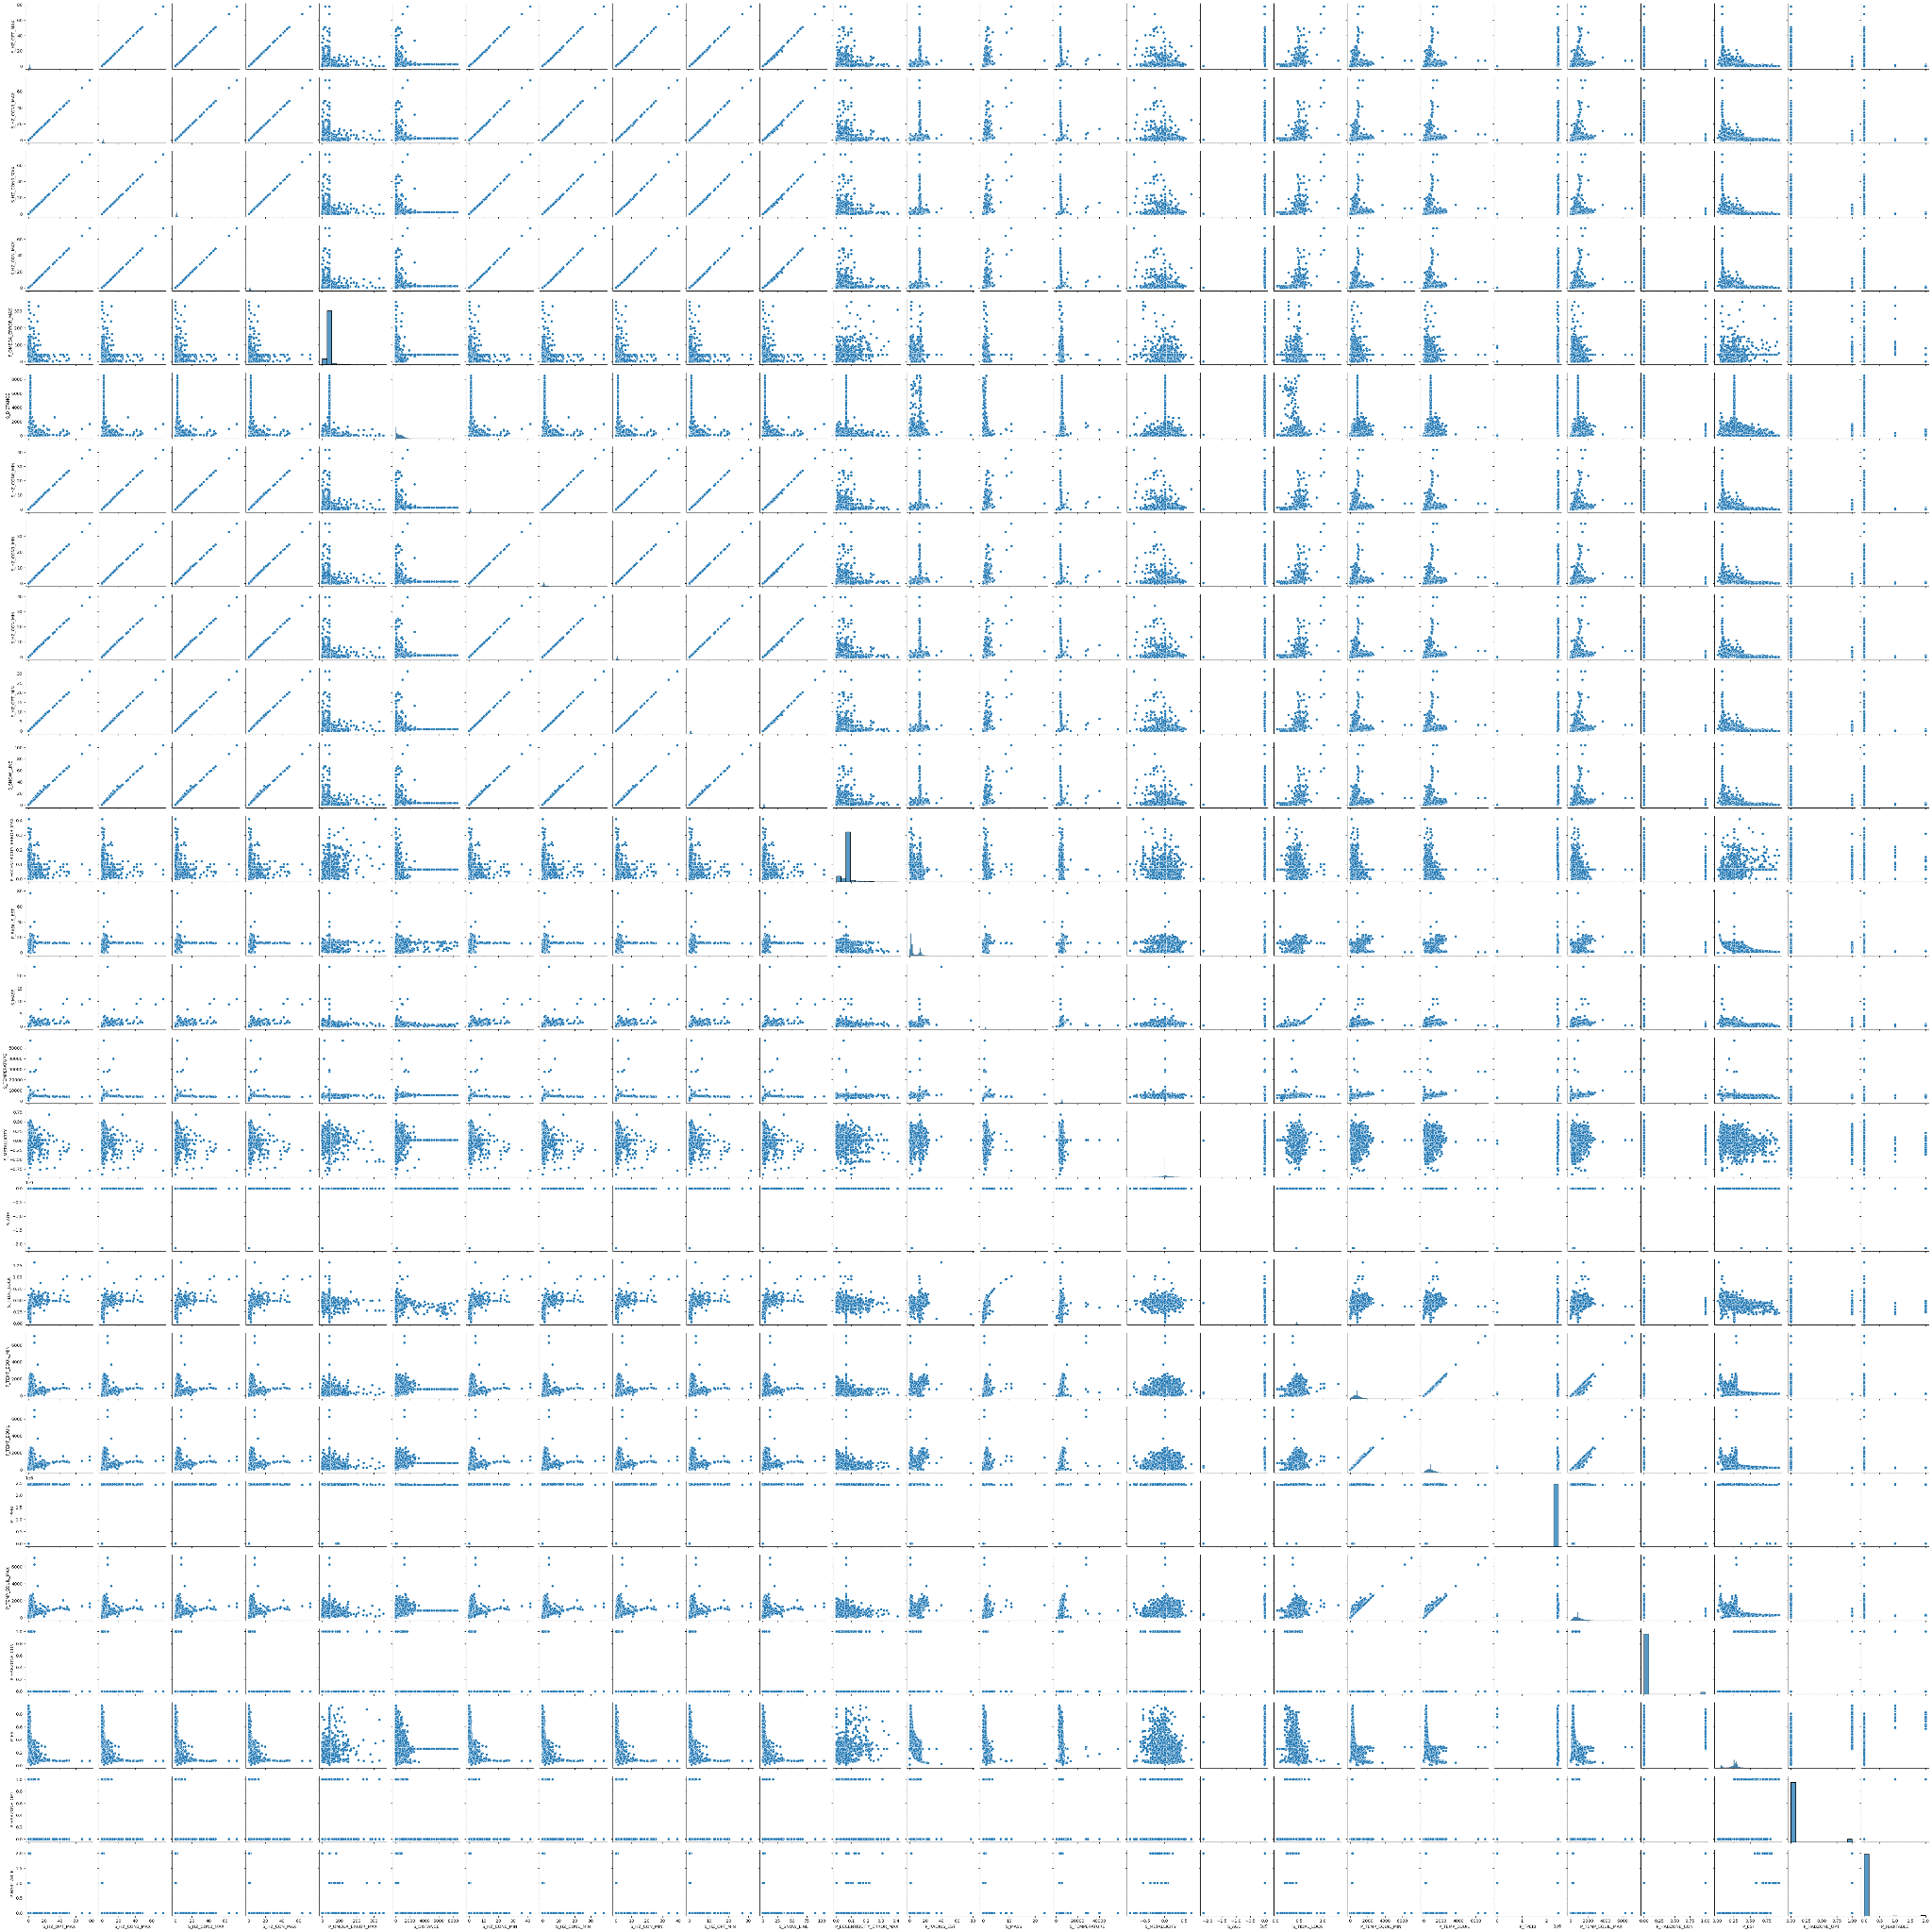
Pair-Plot

Slide 11
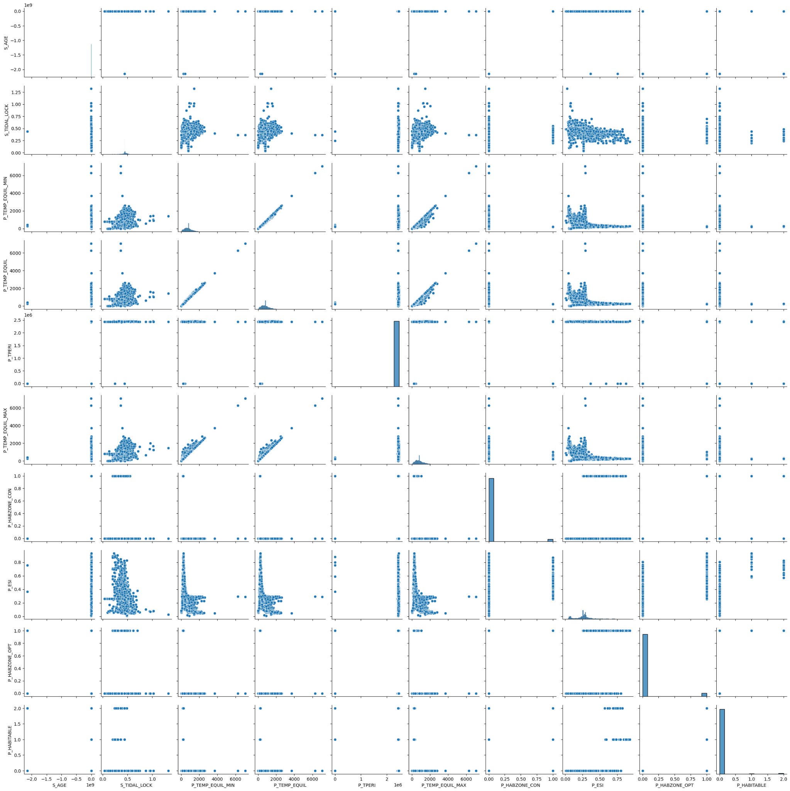
Pair-Plot
Top 10

Slide 12
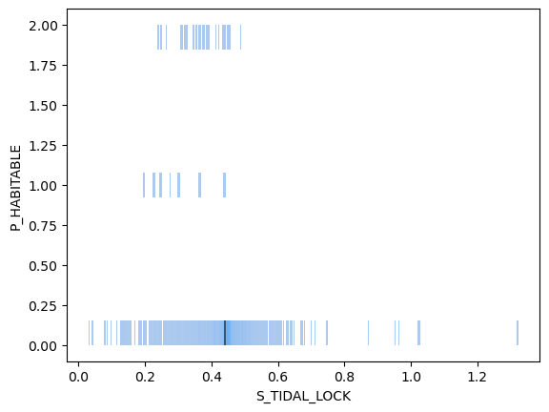
Histplot:
Tidal Lock
Habitability

Slide 13
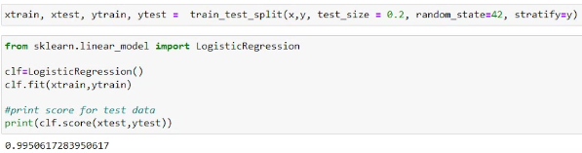
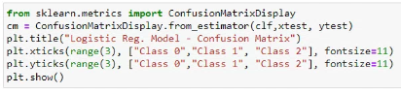
Baseline Model
⇒

Slide 14
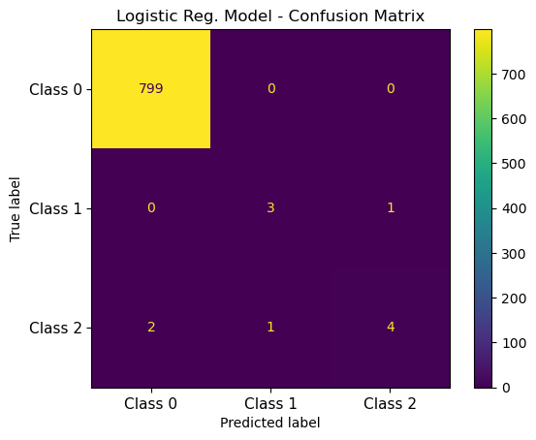
Logistic Regression
Logistic Regression on Top 25

Slide 15
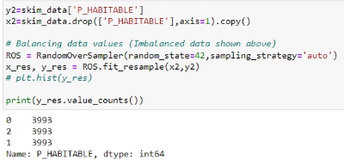
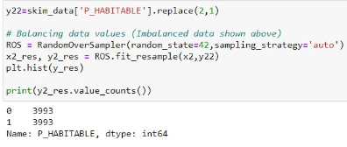
Random Over Sampling (ROS)

Slide 16
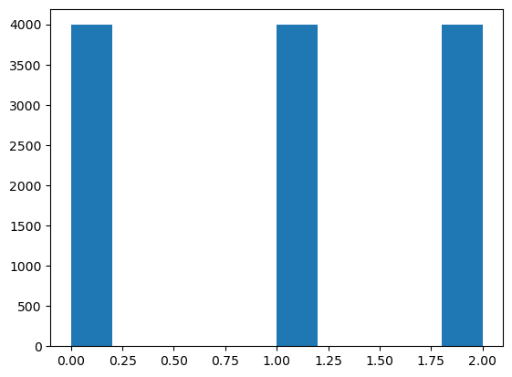
Results of Random Oversampling

Slide 17
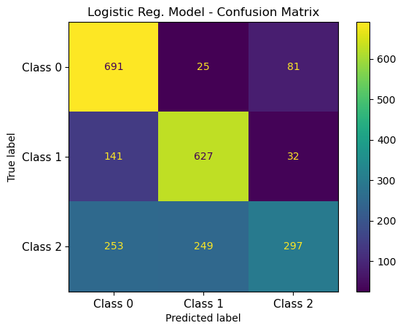
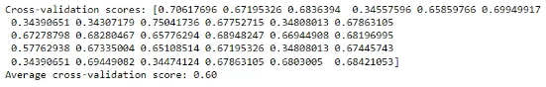
Logistic Regression
Logistic Regression after Random Oversampling

Slide 18
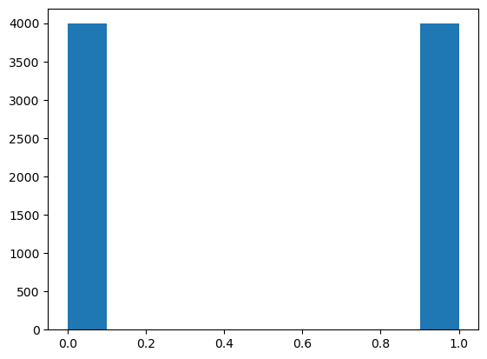
Random Oversampling after combining 1 & 2

Slide 19
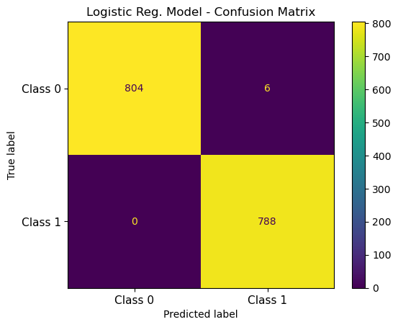
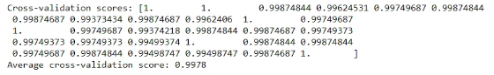
Logistic Regression
Logistic Regression after combining classifications 1 & 2

Slide 20
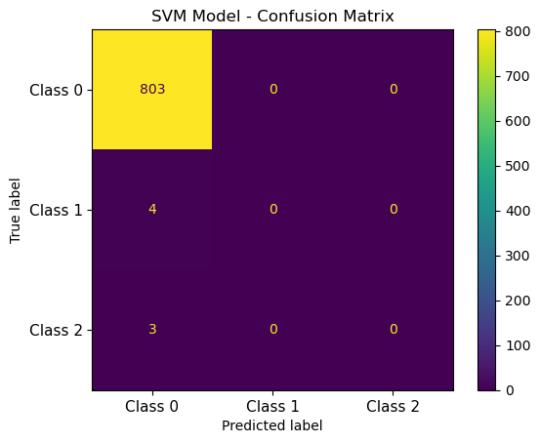
Support Vector Machine
SVM on Top 25, before processing

Slide 21

Support Vector Machine
SVM after combining classifications
1 & 2

Slide 22
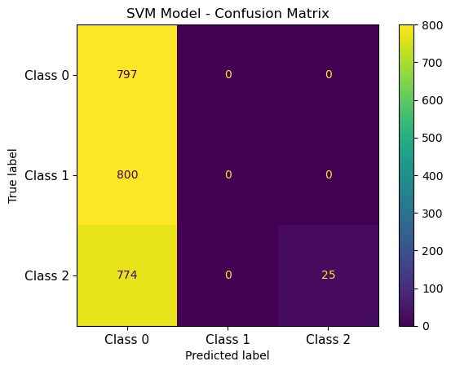
Support Vector Machine
SVM on Random Oversampled data

Slide 23
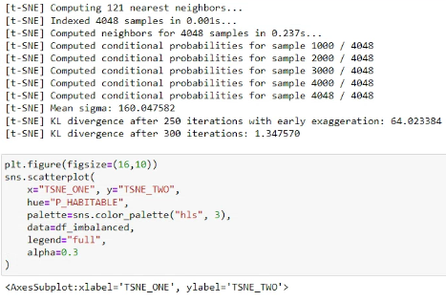
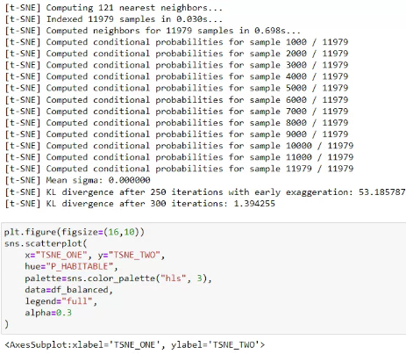
T-SNE (Imbalanced and Balanced)

Slide 24
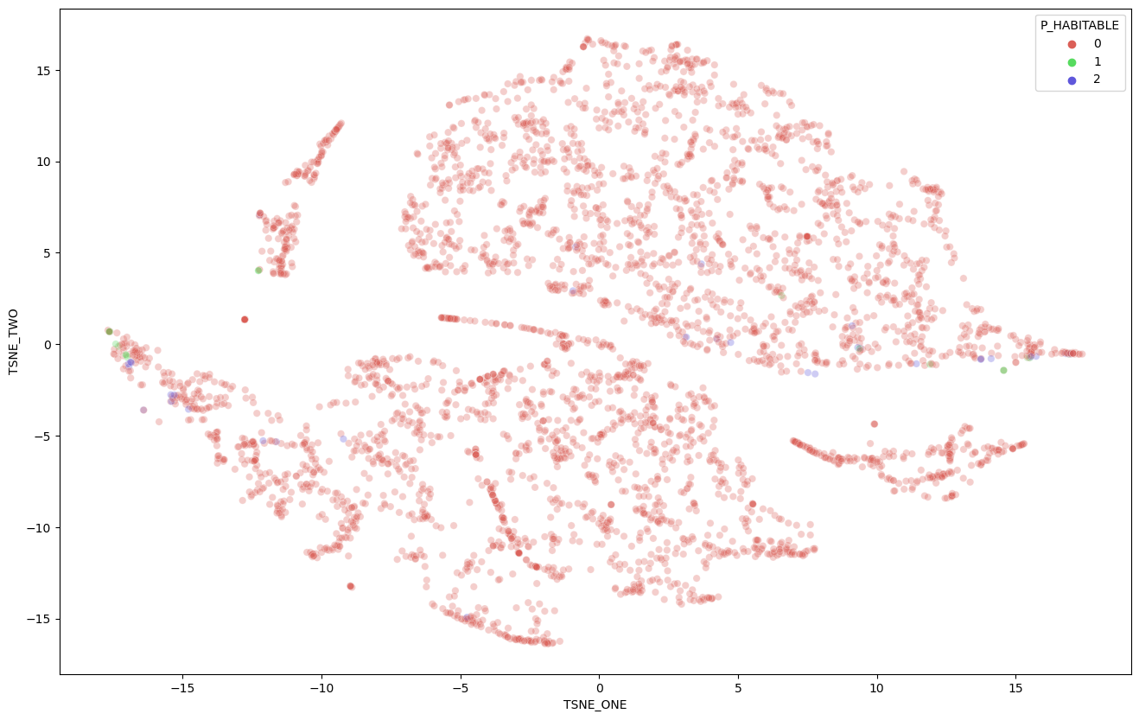

Slide 25
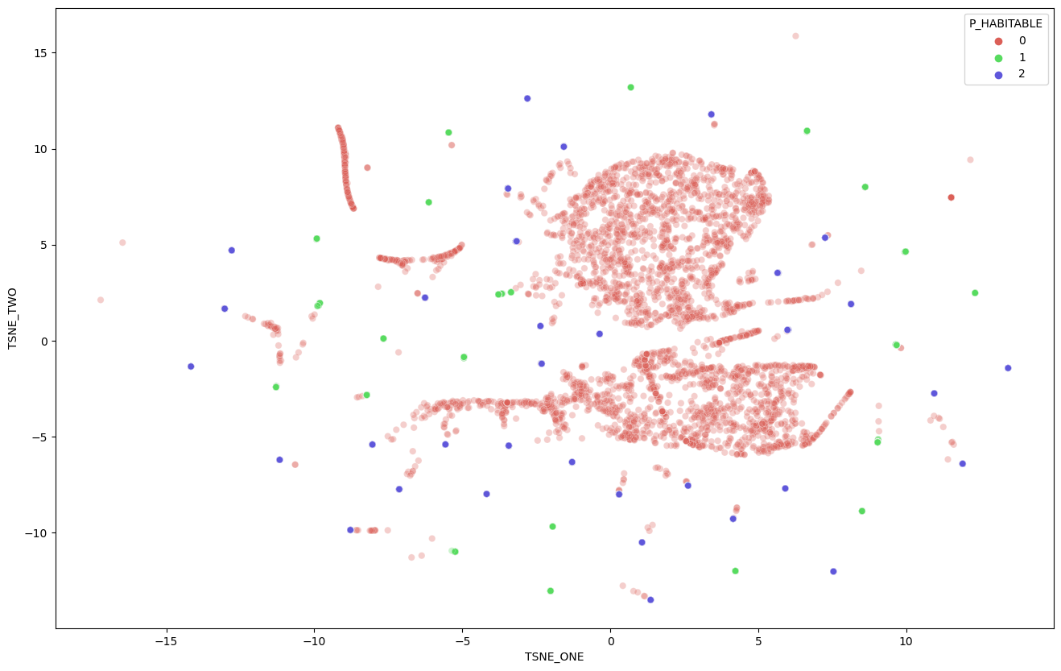

Slide 26
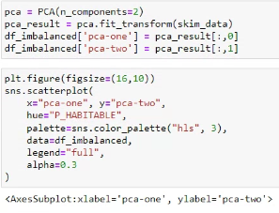
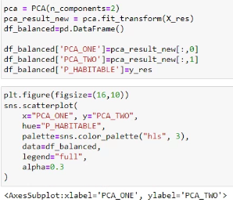
PCA Plots

Slide 27
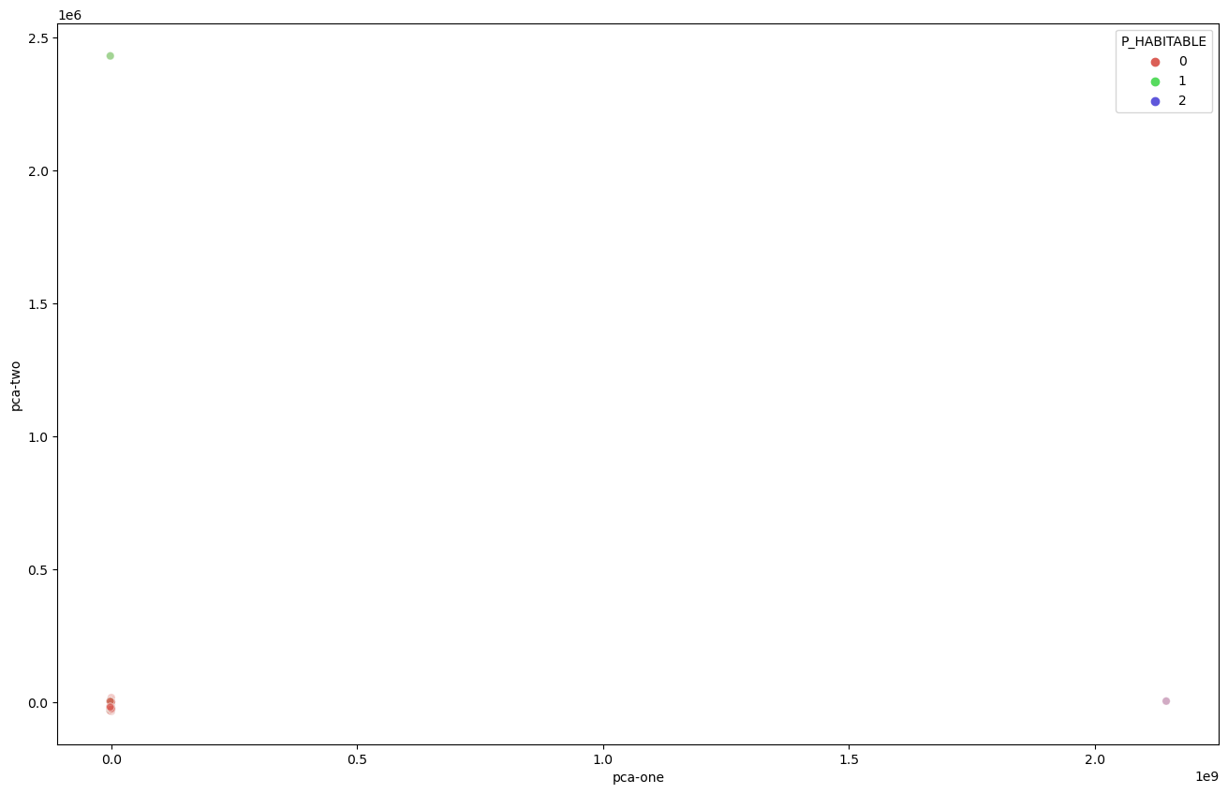

Slide 28
